Slide 1
Working with Databases
Chapter 11

Slide 2
Objectives
1
2
Databases and Web Development
Structured Query Language (SQL)
3
4
Database APIs
Managing a MySQL Database
5
6
Accessing MySQL in PHP
Case Study Schemas
7
7
Sample Database Techniques

Slide 3
Databases and Web Development
Section 1 of 7

Slide 4
Databases and Web Development
This chapter covers the core principles of relational Database Management Systems (DBMSs).
All database management systems are capable of
managing large amounts of data,
maintaining data integrity,
responding to many queries,
creating indexes and triggers, and more.
The term database can refer to both the software (i.e., to the DBMS) and to the data that is managed by the DBMS.

Slide 5
MySQL
We will be using MySQL
There are many other open source and proprietary relational DBMS, including:
PostgreSQL
Oracle Database
IBM DB2
Microsoft SQL Server
MySQL

Slide 6
Transactions
An Advanced Topic.
Anytime one of your PHP pages makes changes to the database via an UPDATE, INSERT, or DELETE statement, you also need to be concerned with the possibility of failure.
A transaction refers to a sequence of steps that are treated as a single unit, and provide a way to gracefully handle errors and keep your data properly consistent when errors do occur.

Slide 7
Transactions
An Example
Imagine how a purchase would work in a web storefront. After the user has verified the shipping address, entered a credit card, and selected a shipping option and clicks the final Pay for Order button? Imagine that the following steps need to happen.
Write order records to the website database.
Check credit card service to see if payment is accepted.
If payment is accepted, send message to legacy ordering system.
Remove purchased item from warehouse inventory table and add it to the order shipped table.
Send message to shipping provider.

Slide 8
Transactions
An Example
At any step in this process, errors could occur. For instance:
The DBMS system could crash after writing the first order record but before the second order record could be written.
The credit card service could be unresponsive, or the credit card payment declined.
The legacy ordering system or inventory system or shipping provider system could be down.

Slide 9
Transactions
Multiple types
Local Transactions can be handled by the DBMS.
Distributed Transactions involve multiple hosts, several of which we may have no control over.
Distributed transactions are much more complicated than local transactions

Slide 10
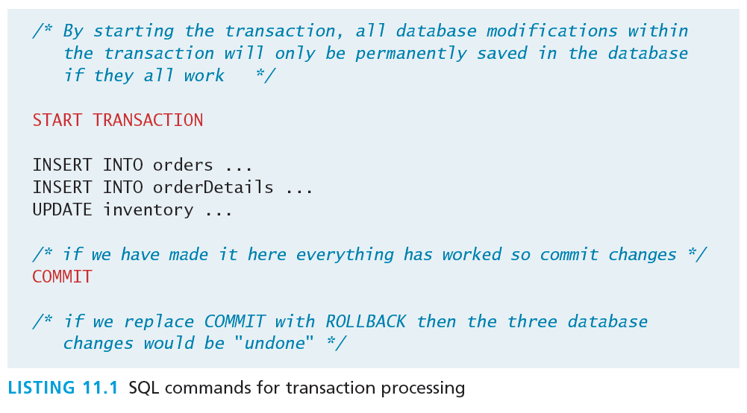
Local Transactions
The easy transactions
The SQL for transactions use the START TRANSACTION, COMMIT, and ROLLBACK commands

Slide 11
Database Indexes
Efficiency
In large sets of data, searching for a particular record can take a long time.
Consider the worst-case scenario for searching where we compare our query against every single record. If there are n elements we say it takes O(n) time to do a search (we would say “Order of n”).
In comparison, a balanced binary tree data structure can be searched in O(log2 n) time.
N= 1,000,000
log2 (1000000) = 20 ← much faster

Slide 12
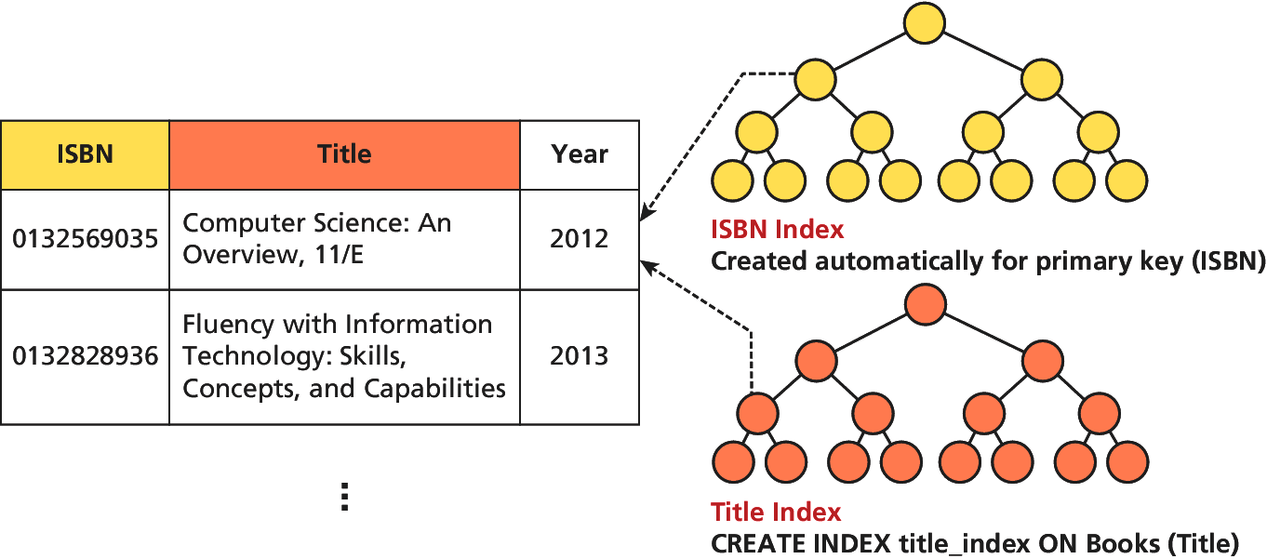
Database Indexes
Use balanced trees or other efficient structures
No matter which data structure is used, the application of that structure to ensure results are quickly accessible is called an index. Every node in the index has just that field, with a pointer to the full record (on disk)

Slide 13
Database APIs
Section 3 of 7

Slide 14
API
Application Programming Interface
API stands for application programming interface and in general refers to the classes, methods, functions, and variables that your application uses to perform some task.
Some database APIs work only with a specific type of database; others are cross-platform and can work with multiple databases.

Slide 15
PHP MySQL APIs
There is more than 1
MySQL extension.
Original extension to PHP for working with MySQL.
Replaced with the newer mysqli extension.
Procedural API to be used only with versions of MySQL older than 4.1.3.
mysqli extension.
Provides both a procedural and an object-oriented approach. This extension also supports most of the latest features of MySQL.
PHP data objects (PDOs).
This object-oriented API has been available since PHP 5.1
Provides an abstraction layer (i.e., a set of classes that hide the implementation details for some set of functionality) that with the appropriate drivers can be used with any database, and not just MySQL databases. However, it is not able to make use of all the latest features of MySQL.

Slide 16
ManaginG a MySQL Database
Section 4 of 7

Slide 17
How do you access the DBMS
So, so many ways
Although you will eventually be able to manipulate the database from your PHP code, there are some routine maintenance operations that do not warrant custom code. Tools include:
Command Line Interface
phpMyAdmin
MySQLWorkbench

Slide 18
Command Line Interface
Oldie but a goodie.
Specify the host, username, and database name to connect to as shown below:
mysql -h 192.168.1.14 -u bookUser –p
Once inside of a session, you may enter any SQL query, terminated with a semicolon (;)

Slide 19
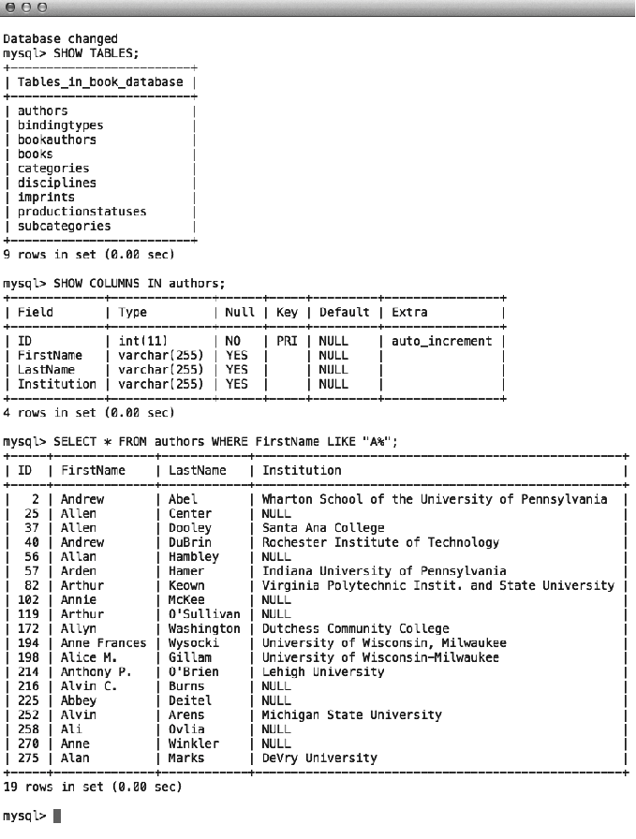
Command Line Interface
Oldie but a goodie.

Slide 20
Command Line Interface
I bet you’ll use it oneday…
To import commands from a file called commands.sql, for example, we would use the < operation:
mysql –h 192.168.1.14 –u bookUser –p < commands.sql
Although GUI tools allow this as well, the CLI can be integrated into automated scripts to aid with mirroring, backup, and recovery.

Slide 21
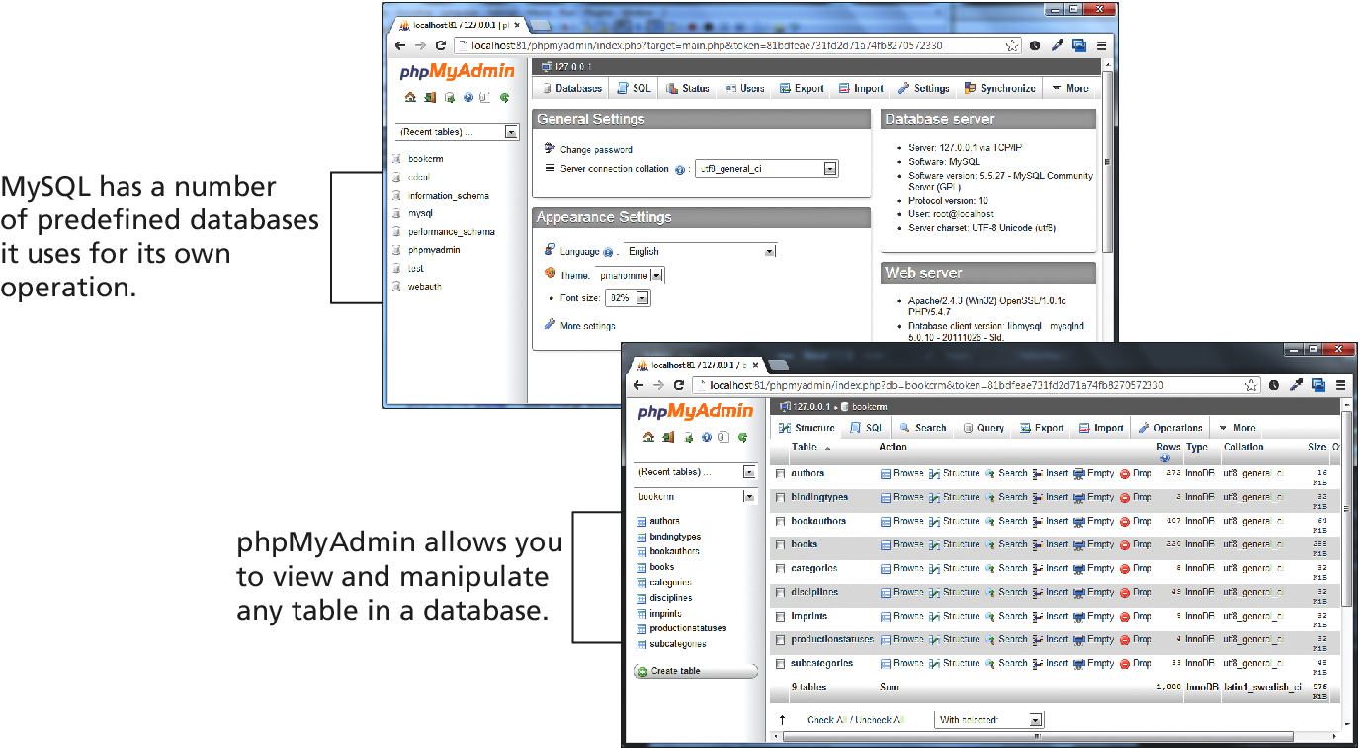
phpMyAdmin
Will even generate PHP code
A popular web-based front-end (written in PHP) called phpMyAdmin allows developers to access management tools through a web portal.

Slide 22
MySQL Workbench
Powerful design tools
The MySQL Workbench is a free tool from Oracle to work with MySQL databases.

Slide 23
Accessing MySQl in PHP
Section 5 of 7

Slide 24
Database Connection Algorithm
No matter what API you use, the basic database connection algorithm is the same:
Connect to the database.
Handle connection errors.
Execute the SQL query.
Process the results.
Free resources and close connection.

Slide 25
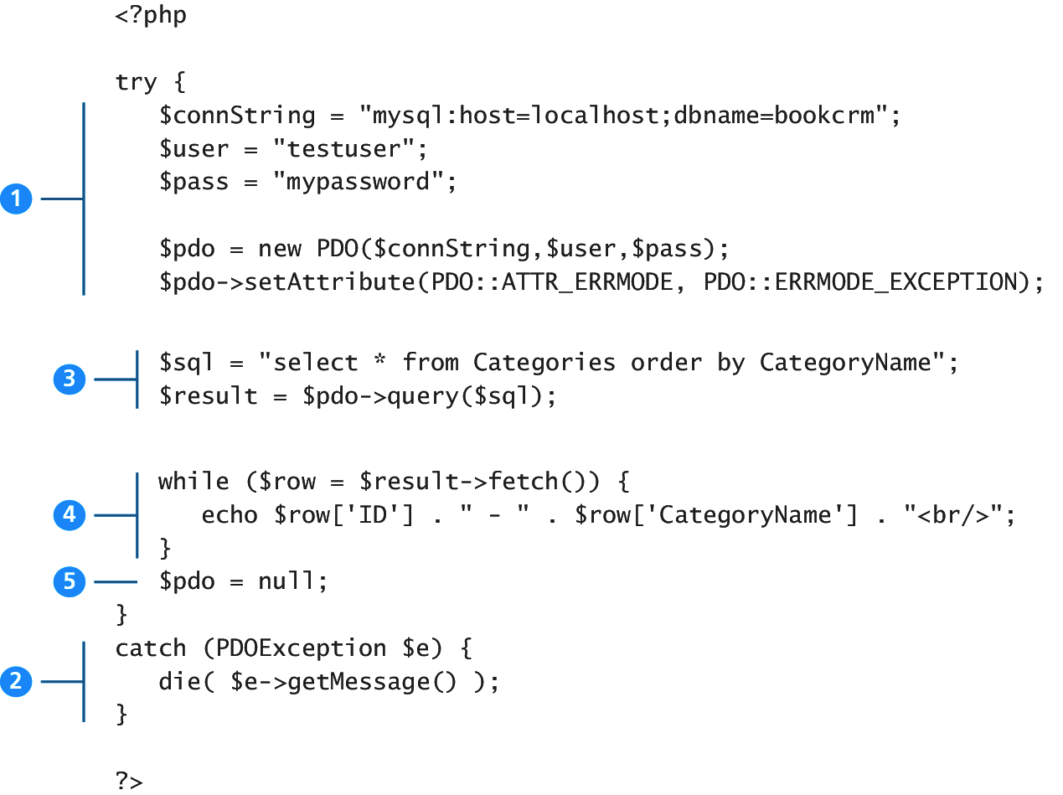
Database Connection Algorithm
An illustration through example
connect
Execute the query
Process the results
Free and close
Handle errors

Slide 26
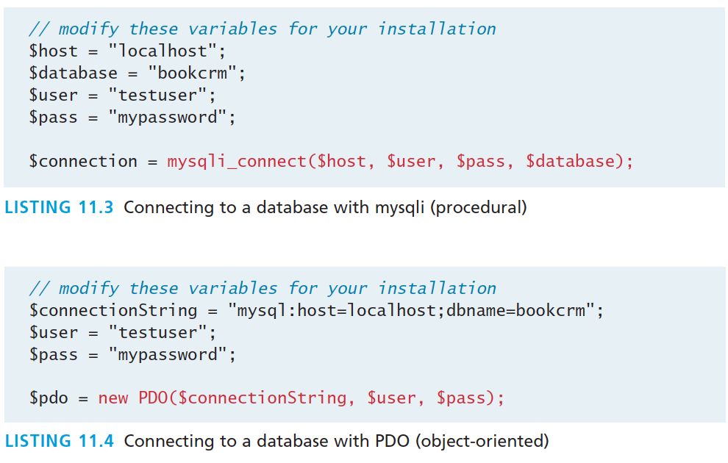
Database Connection Algorithm
An illustration through example

Slide 27
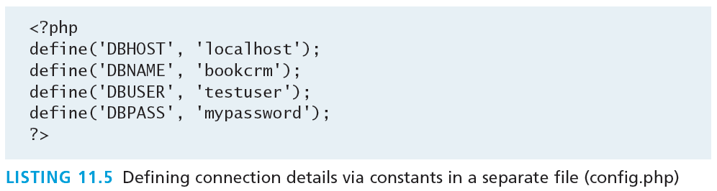
Storing Connection Details
Hard-coding the database connection details in your code is not ideal.
Connection details almost always change as a site moves from development, to testing, to production.
We should move these connection details out of our connection code and place it in some central location.

Slide 28
Handling Connection Errors
We need to handle potential connection errors in our code.
Procedural mysqli techniques use conditional (if...else) statements on the returned object from the connection attempt.
The PDO technique uses try-catch which relies on thrown exceptions when an error occurrs.

Slide 29
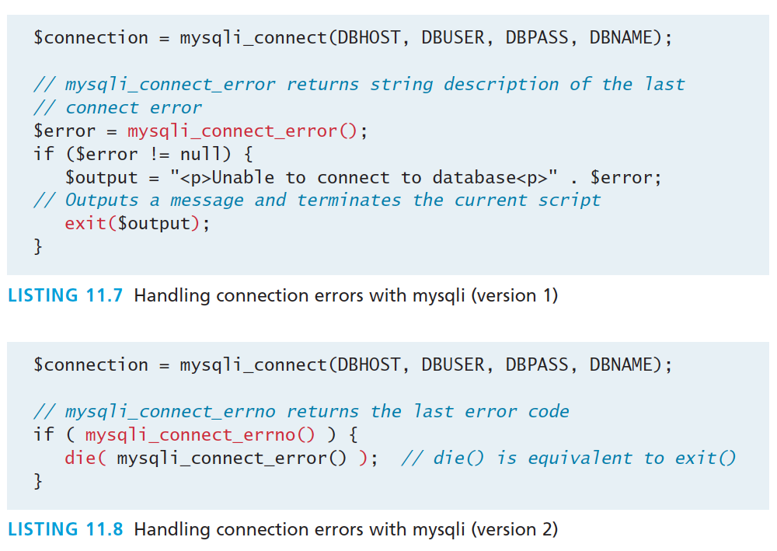
Handling Connection Errors
Procedural Approach

Slide 30
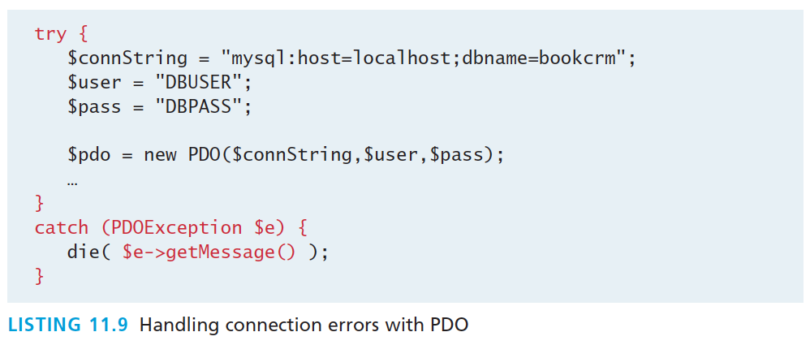
Handling Connection Errors
Object-Oriented PDO with try-catch
In addition PDO has 3 different error modes, that allow you to control when errors are thrown.

Slide 31
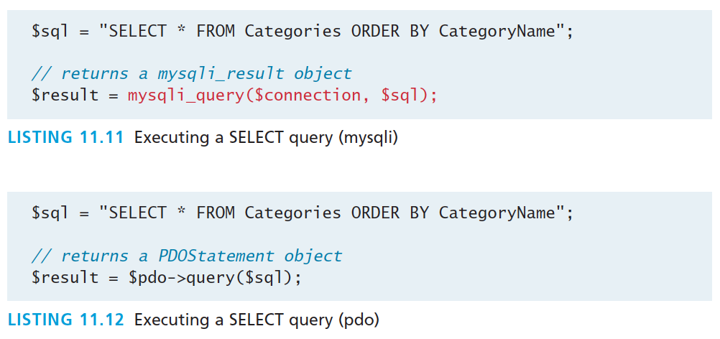
Execute the Query
Procedural and Object-Oriented
Both return a result set, which is a type of cursor or pointer to the returned data

Slide 32
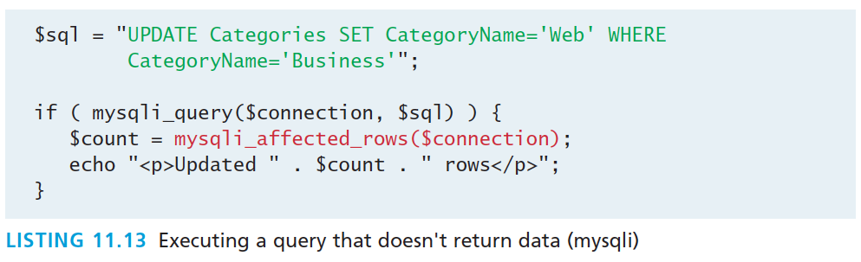
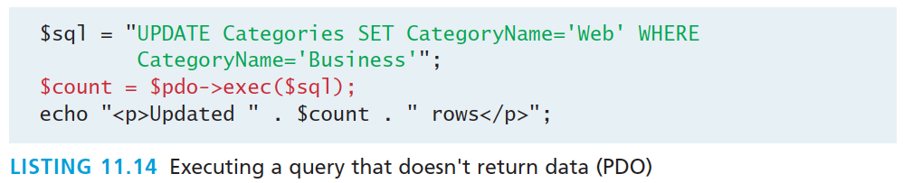
Queries that don’t return data
Procedural and Object-Oriented

Slide 33
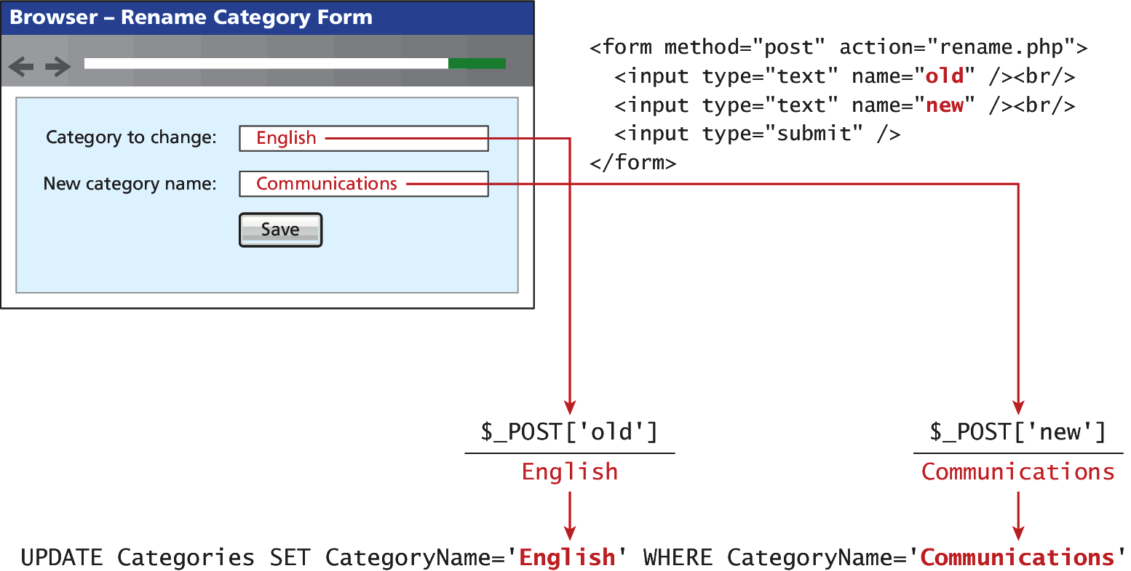
Integrating User Data
Say, using an HTML form posted to the PHP script

Slide 34
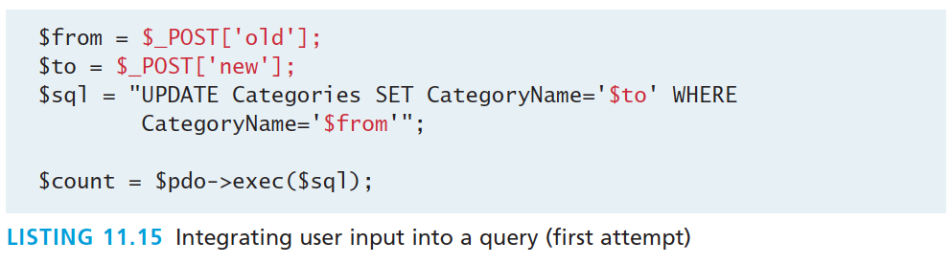
Integrating User Data
Not everyone is nice.
While this does work, it opens our site to one of the most common web security attacks, the SQL injection attack.

Slide 35
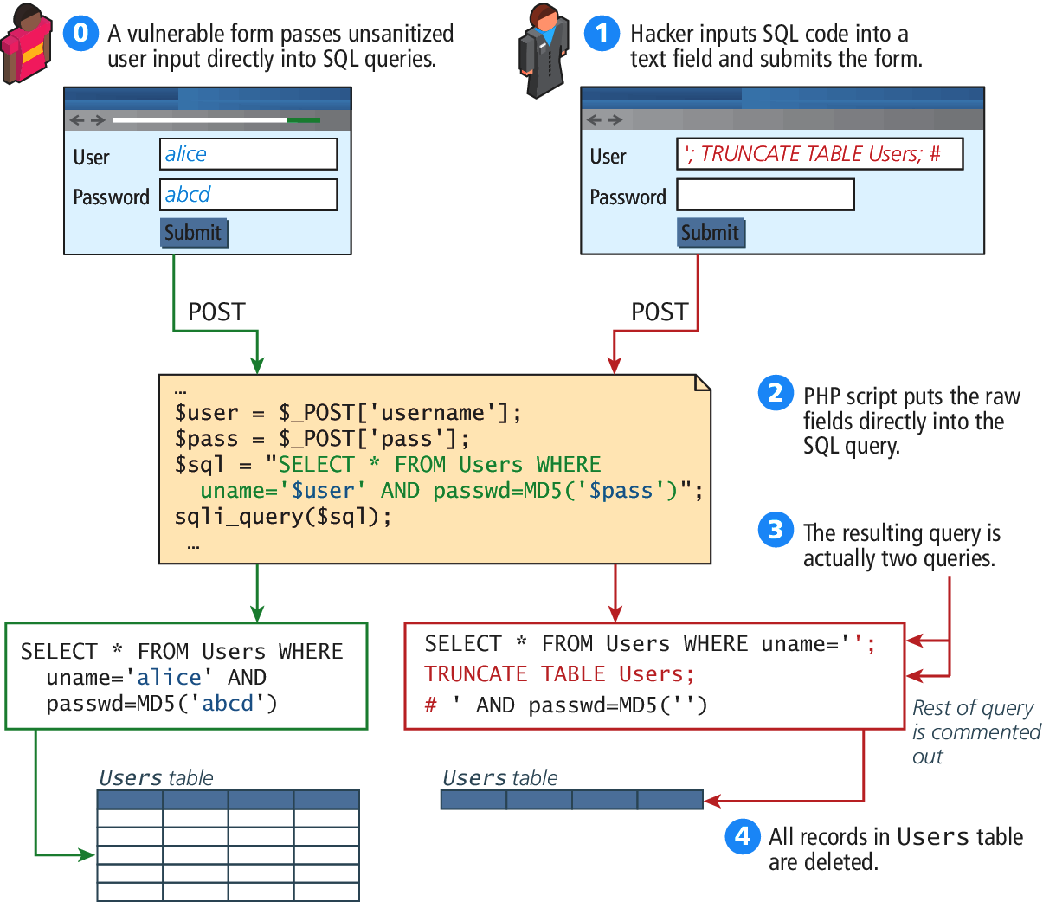
SQL Injection Illustration
From Chapter 16

Slide 36
Defend against attack
Distrust user input
The SQL injection class of attack can be protected against by
Sanitizing user input
Using Prepared Statements

Slide 37
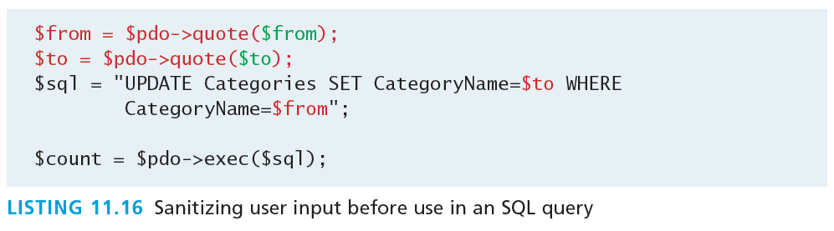
Sanitize User Input
Quick and easy
Remove remove any special characters from a desired piece of text.
User inputs can be sanitized in PHP using the mysqli_real_escape_string() method or, if using PDO, the quote() method

Slide 38
Prepared Statements
Better in general
A prepared statement a way to improve performance for queries that need to be executed multiple times.
A prepared statement optimizes it so that it has superior performance for multiple requests.
It also integrates sanitization into each user input automatically, thereby protecting us from SQL injection.

Slide 39
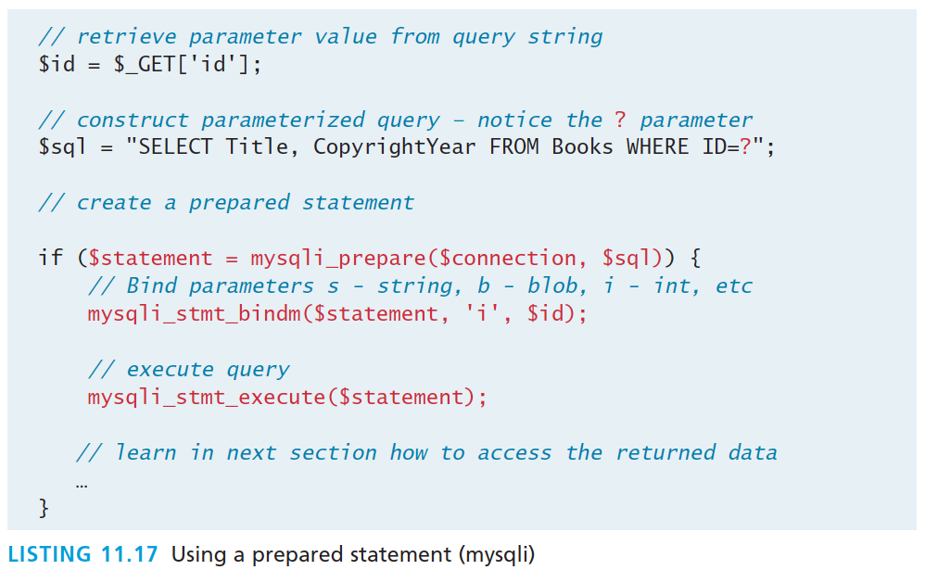
Prepared Statements
mysqli

Slide 40
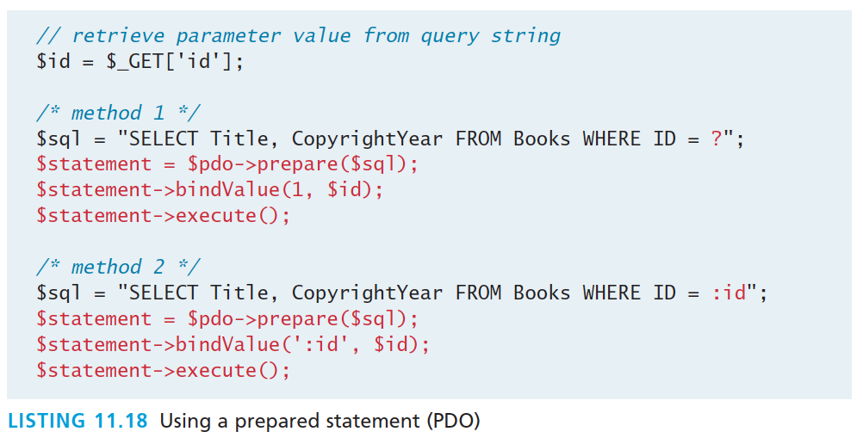
Prepared Statements
PDO

Slide 41
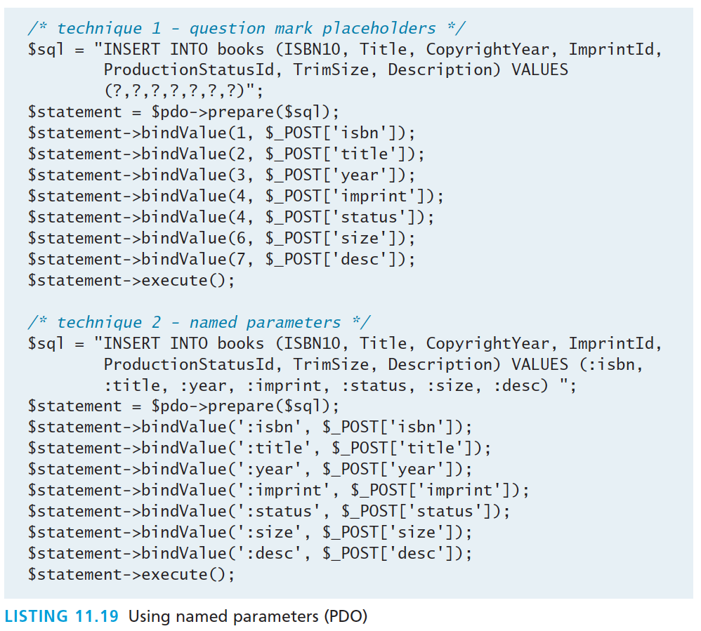
Prepared Statements
Comparison of two techniques

Slide 42
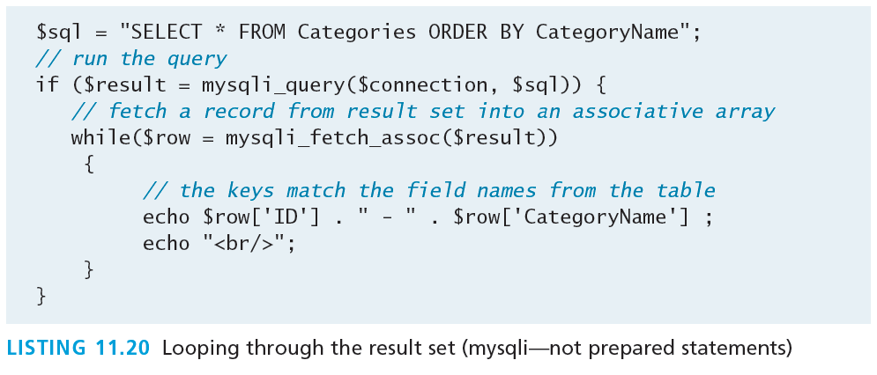
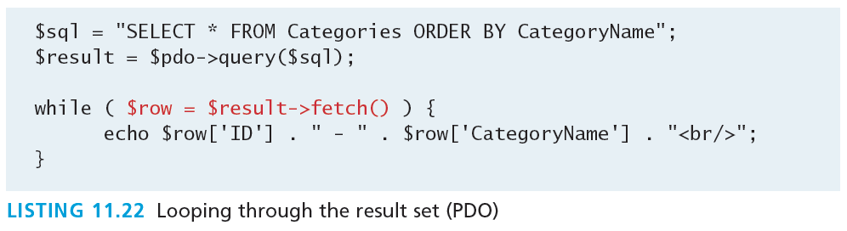
Process Query Results
mysqli

Slide 43
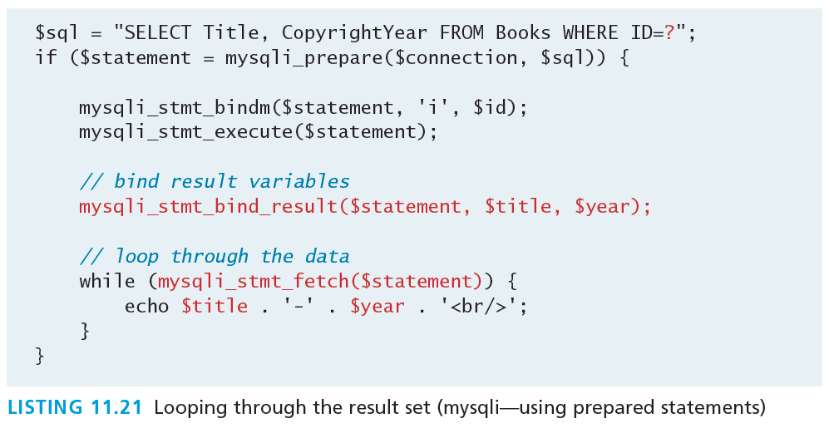
Process Query Results
Mysqli – using prepared statements

Slide 44
Fetch into an object
Instead of an array
Consider the following (very simplified) class:
class Book {
public $id; public $title; public $copyrightYear; public $description; }

Slide 45
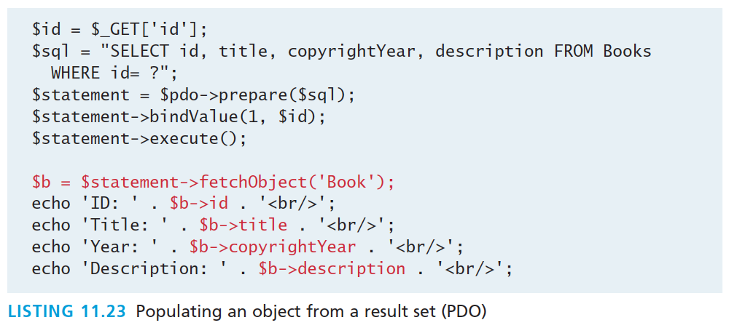
Fetch into an object
Instead of an array
The property names must match exactly (including the case) the field names in the table(s) in the query

Slide 46
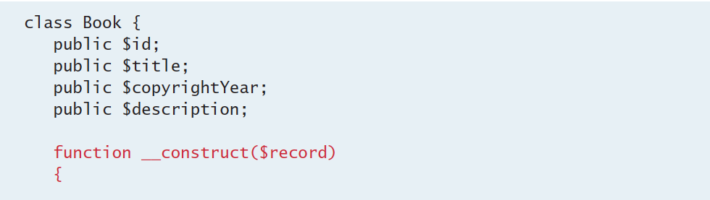
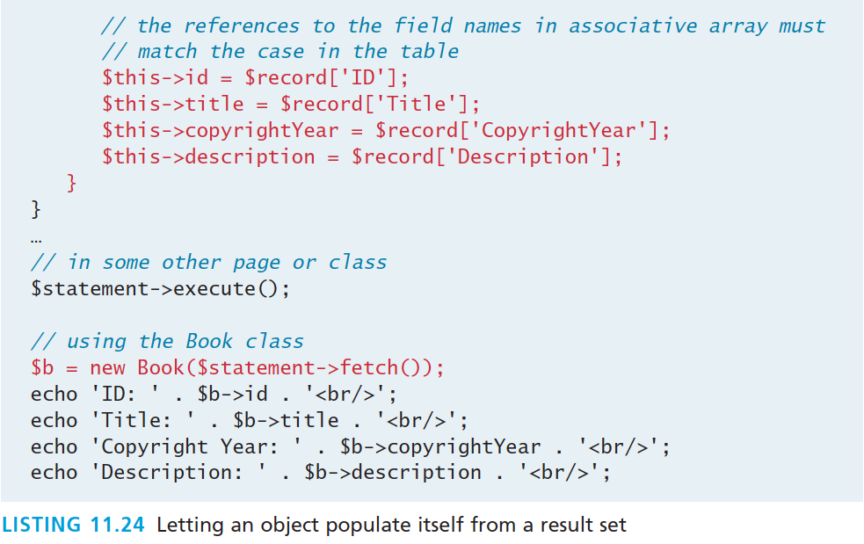
Fetch into an object
A more flexible example, where class names needn’t match DB fields

Slide 47
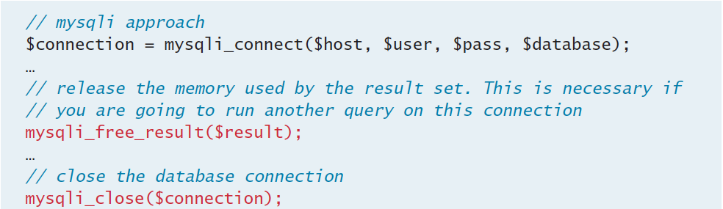
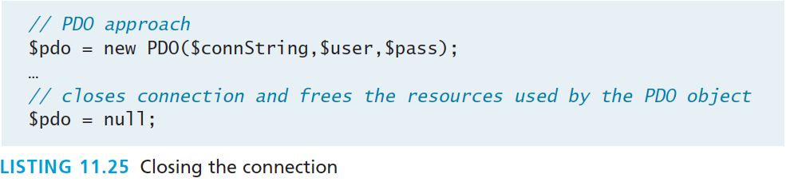
Freeing Resources
And closing the connection

Slide 48
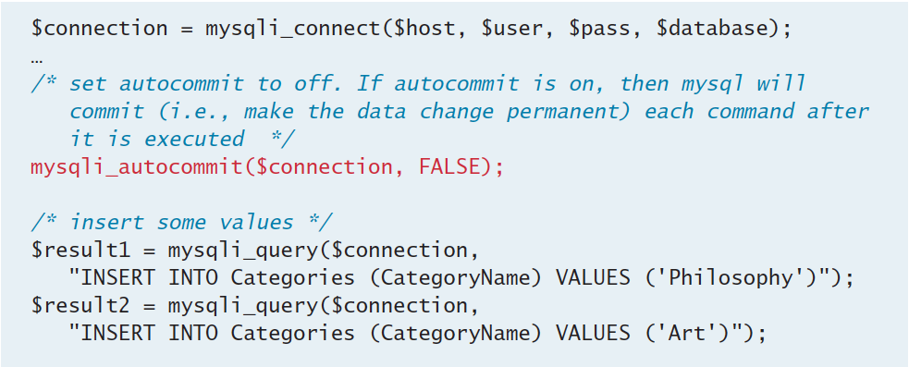
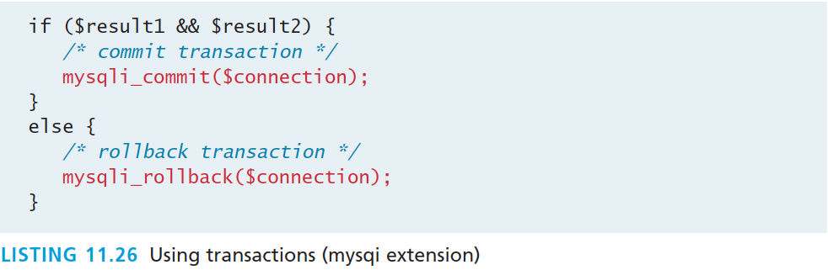
Using Transactions
mysqli

Slide 49
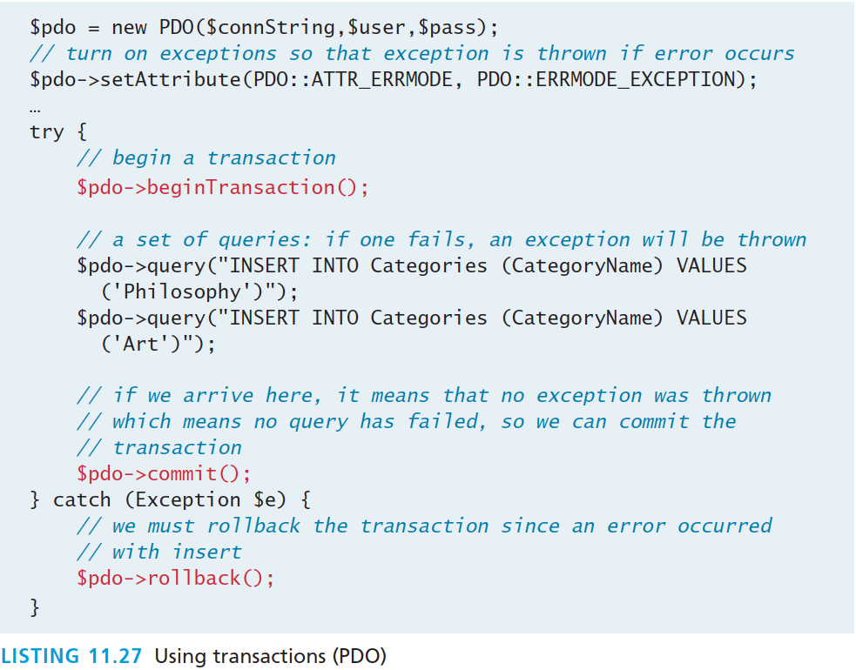
Using Transactions
PDO

Slide 50
Case Study Schemas
Section 6 of 7

Slide 51
Art Database

Slide 52
Book CRM Database
Customer Relationship Management

Slide 53
Travel Photo Sharing Database

Slide 54
Sample Database Techniques
Section 7 of 7

Slide 55
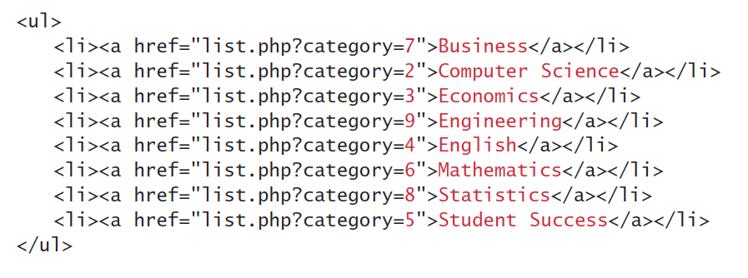
Display a list of Links
One of the most common database tasks in PHP is to display a list of links (i.e., a series of <li> elements within a <ul>).

Slide 56
Display a list of Links
At its simplest, the code would look something like the following:
$sql = "SELECT * FROM Categories ORDER BY CategoryName”; $result = $pdo->query($sql); while ($row = $result->fetch()) { echo '<li>’; echo '<a href="list.php?category=' . $row['ID'] . '">’; echo $row['CategoryName']; echo '</a>’; echo '</li>’; }

Slide 57
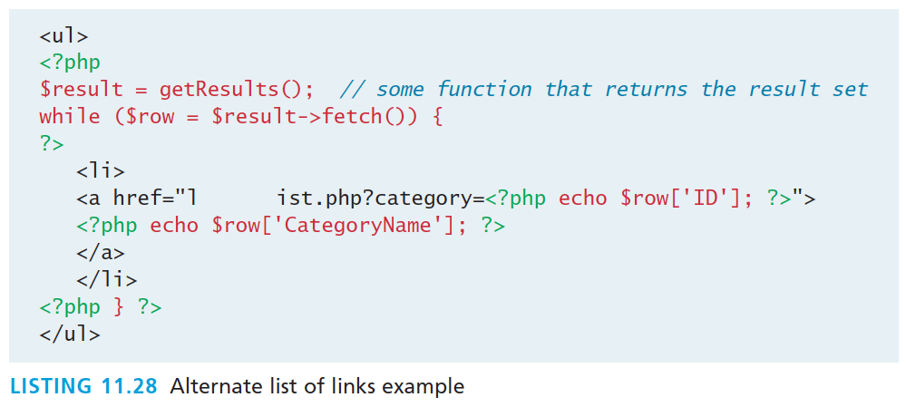
Display a list of Links
More maintainable version

Slide 58
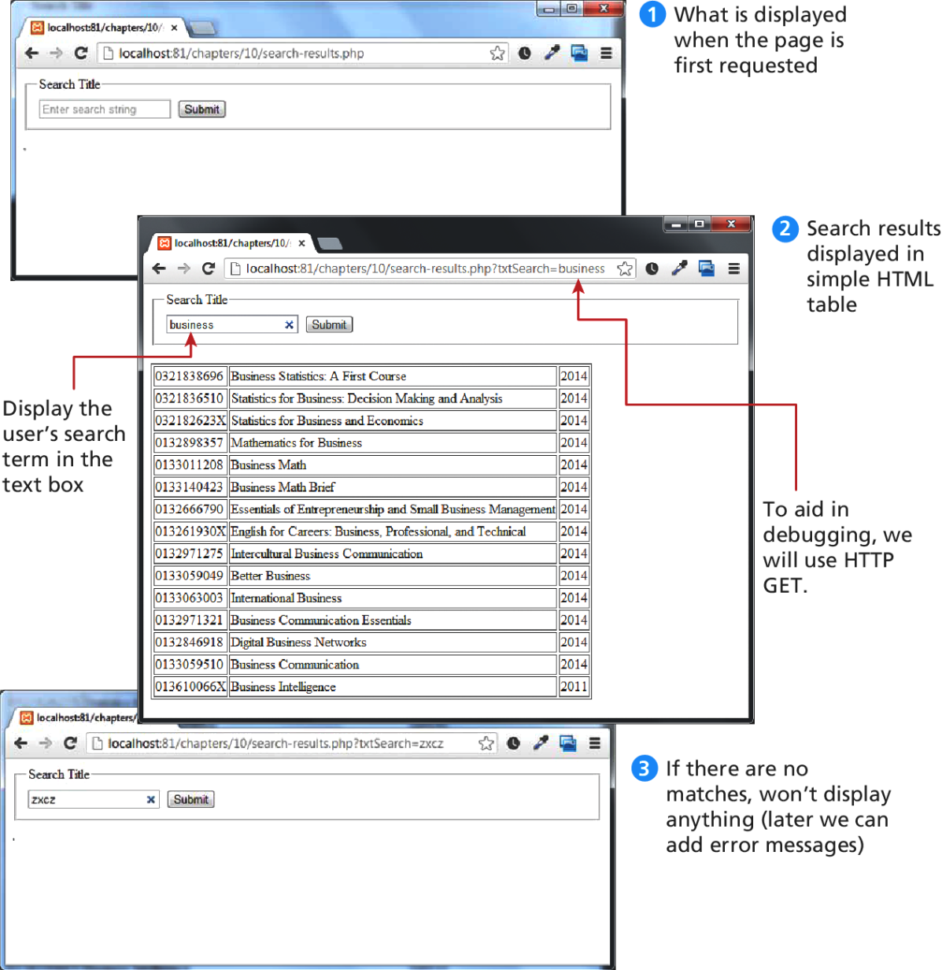
Search and Results Page
Visual of search box, results page, and no results page

Slide 59
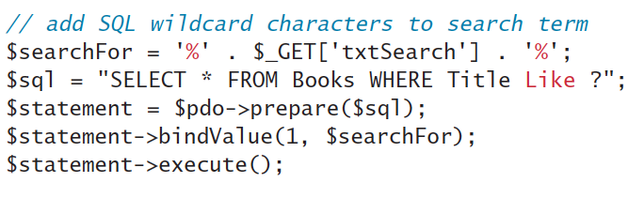
Search and Results Page
In this example, we will assume that there is a text box with the name txtSearch in which the user enters a search string along with a Submit button.
The data that we will filter is the Book table; we will display any book records that contain the user-entered text in the Title field.

Slide 60
Search and Results Page
To redisplay the search term we will add code like:
<input type="search” name="txtSearch” placeholder="Enter search string” value="<?php echo $_GET['txtSearch']; ?>" />

Slide 61
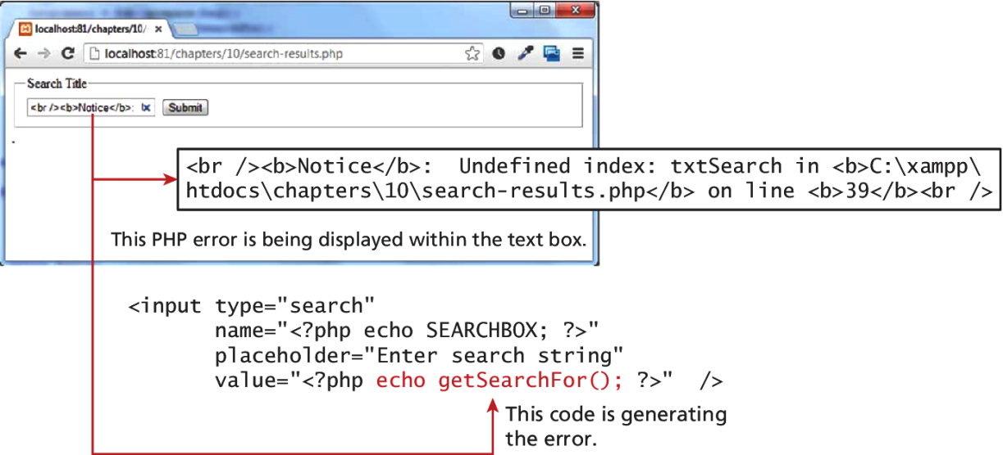
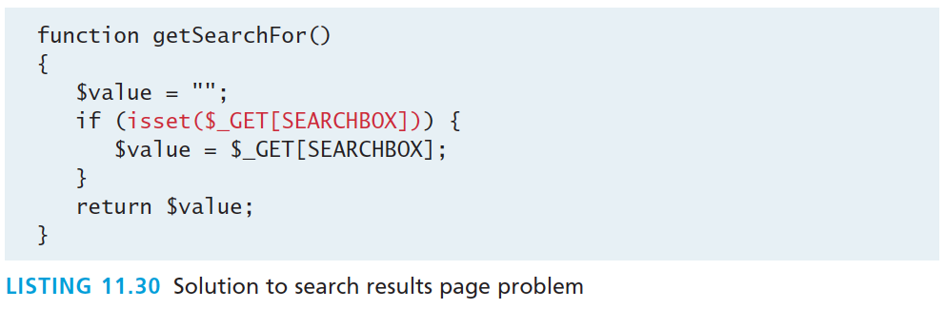
Search and Results Page
Problem to be solved

Slide 62
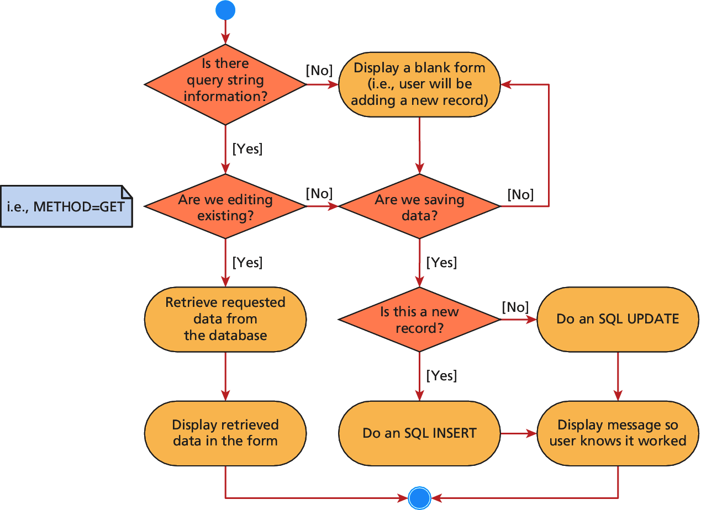
Editing a Record

Slide 63
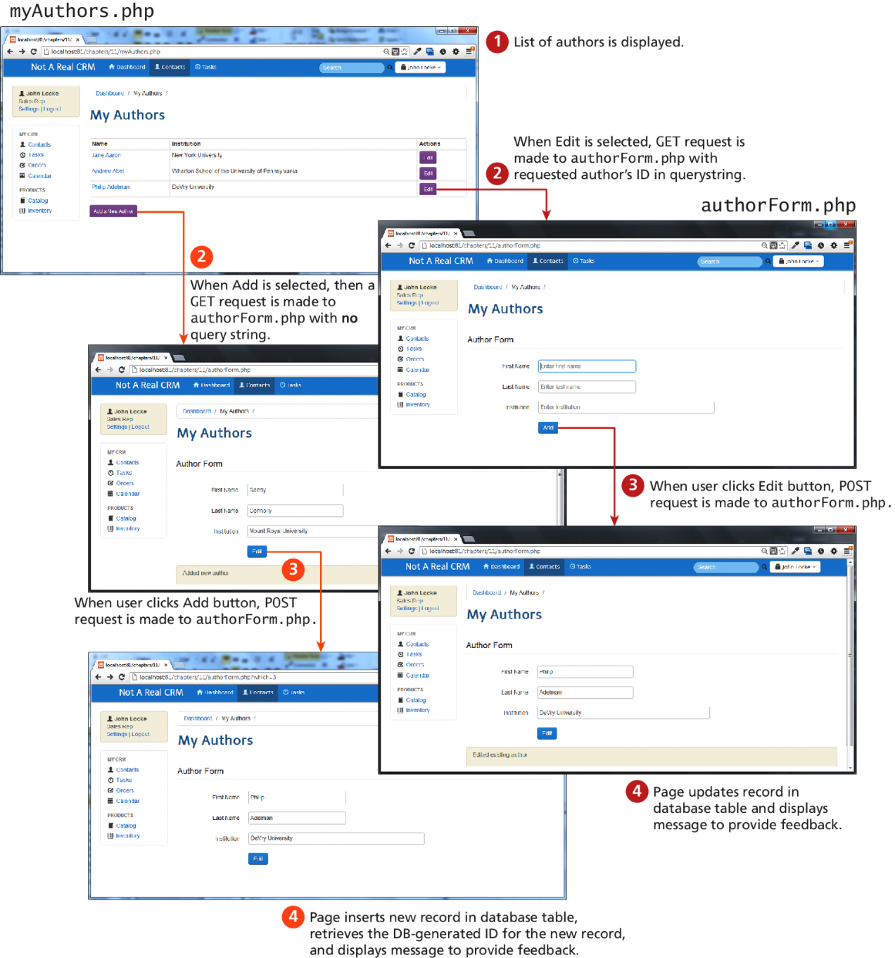
Editing a Record

Slide 64
Files in the Database
There are two ways of storing files in a database:
Storing file location in the database, and storing the file on the server’s filesystem
Storing the file itself in the database in the form of a binary BLOB

Slide 65
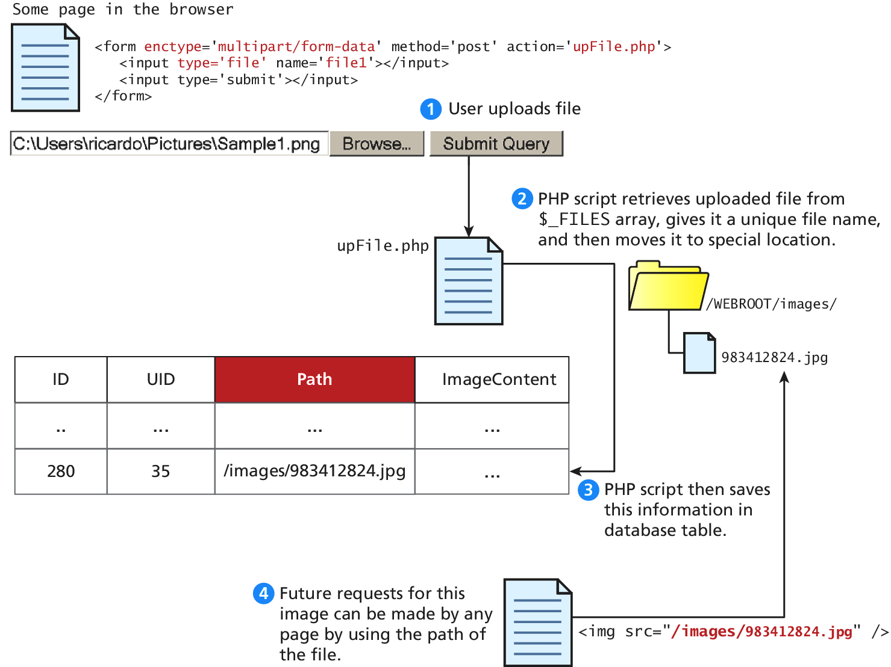
Files in the Database
As a file Location

Slide 66
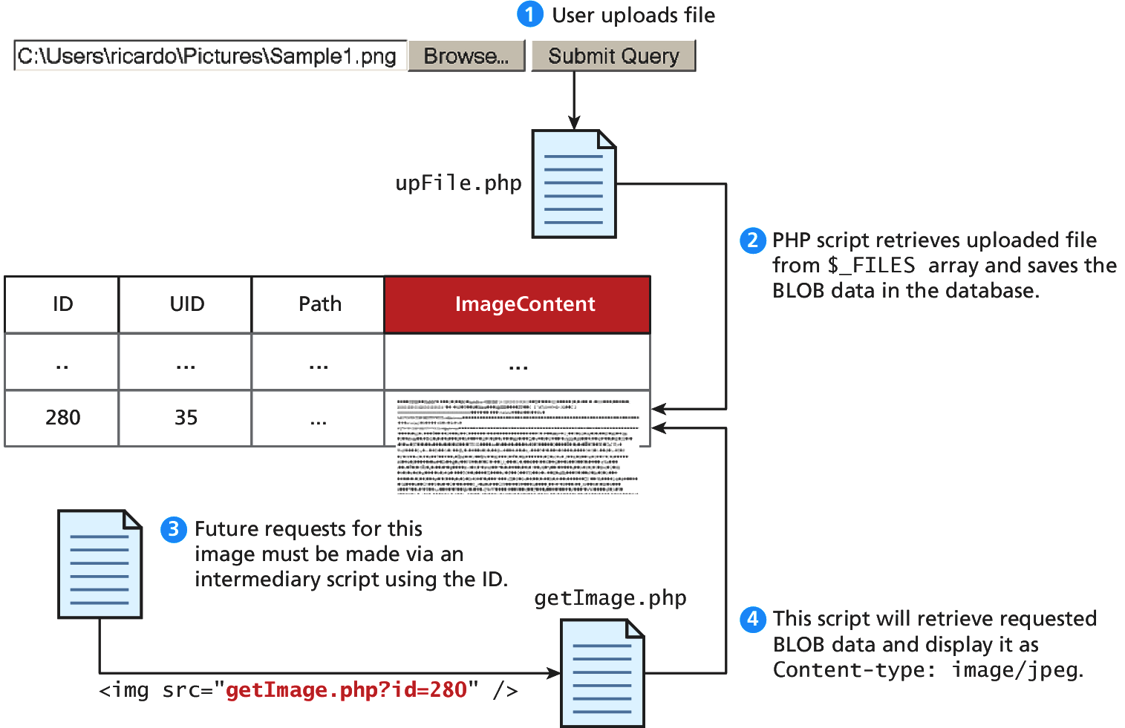
Files in the Database
As a BLOB

Slide 67
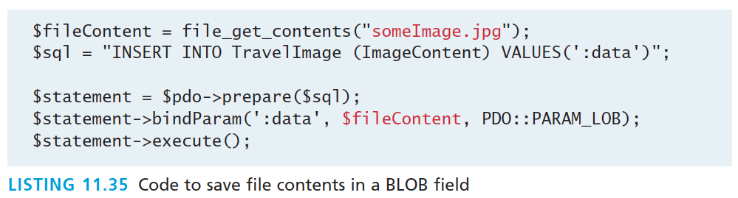
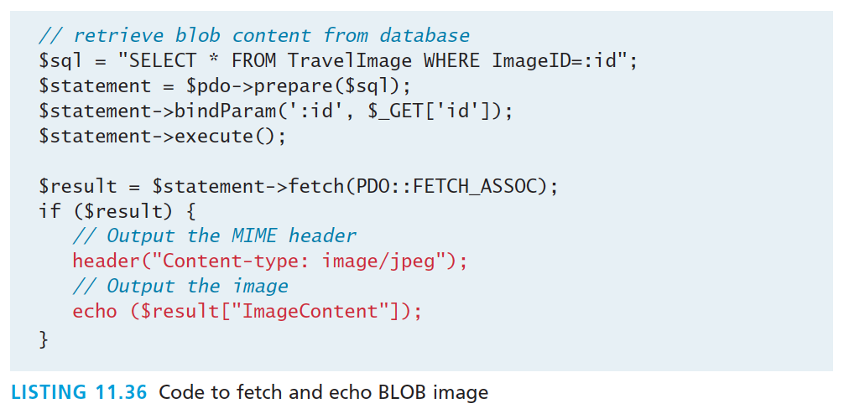
Files in the Database
Storing and retrieving BLOBs

Slide 68
Files in the Database
Storing and retrieving BLOBs
Listing 11.36 can then be integrated into HTML image tags by pointing the src attribute to our script
<img src="/images/Author280.jpg"/>
Would now reference a dynamic PHP script like:
<img src="getImage.php?id=280"/>

Slide 69

Files in the Database
HTTP headers matter
The same file output with correct and incorrect headers is interpreted differently by the browser

Slide 70
What You’ve Learned
1
2
Databases and Web Development
Structured Query Language (SQL)
3
4
Database APIs
Managing a MySQL Database
5
6
Accessing MySQL in PHP
Case Study Schemas
7
7
Sample Database Techniques

